Slide 1
Runspaces
Module 9

Slide 2
Learnings covered in this Unit
Run spaces Overview
[PowerShell] Class
Asynchronous processing (multithreading)
Initialization States
Runspace Pools
Debugging Runs paces

Slide 3
Runspace overview

Slide 4


Runspace Overview
Host – The program running PowerShell (ISE, CLI, VSCode, etc)
Runspace – The process thread that executes PowerShell code
[PowerShell] – The class used to represent PowerShell commands, which can be executed by a runspace – default is the host
The host communicates with the runspace, which does the actual work
Additional runspaces can be created, which can run commands at the same time
Code
Runspace
Output
Host

Slide 5
Runspace Overview
Host – The program running PowerShell (ISE, CLI, VSCode, etc)
Runspace – The process thread that executes PowerShell code
[PowerShell] – The class used to represent PowerShell commands, which can be executed by a runspace – default is the host
The host communicates with the runspace, which does the actual work
Additional runspaces can be created, which can run commands at the same time
Code
Host
Runspace
Output

Slide 6
Runspace Use Cases
Increase the speed of scripts by creating parallel tasks in different threads in the same process
Execute slow data collection while continuing the script until data is needed
Process a lot of data quickly when the order doesn’t matter

Slide 7
Runspace VS PowerShell Jobs
Runspaces
Lightweight - Less resources consumed
Jobs
More overhead - Resource intensive
More work to manage – monitoring, receiving output, disposing
Additional threads in the same process
Convenient management cmdlets – stop, start, wait, resume
Starts a new process host
Less control over what is loaded on initialization
More control on initialization of environment

Slide 8
The [PowerShell] Class
The [PowerShell] class is used to represent commands to be executed later
Script blocks and parameters are added to instances via methods
Commands are executed with .Invoke() on the default runspace
Instances are created using [PowerShell]::Create()
PS> $PSInstance = [PowerShell]::Create()
PS> $PSInstance.AddScript({"Hello world"})
PS> $PSInstance.Invoke()
Hello world
PS> $PSInstance.Dispose()

Slide 9
[PowerShell] Methods
.AddScript()
.AddCommand()
.AddParameter()
.AddArgument()
.Invoke()
.Dispose()
.BeginInvoke()
.EndInvoke()
Add script block to runspace (most common)
Add string to runspace to represent a cmdlet
Adds a parameter positionally to the last added command
Execute commands synchronously
Dispose all managed resources
Execute commands asynchronously
Wait for BeginInvoke() to complete and receive output
Add parameter value by name to last added command

Slide 10
Cleaning Up
Dispose() method releases all managed resources
Prevents memory leaks and other errors
Best practice is to use when available
Often used in finally{} blocks
PS> $PSInstance = [PowerShell]::Create()
PS> $PSInstance.AddScript({"Hello world"})
PS> $PSInstance.Invoke()
Hello world
PS> $PSInstance.Dispose()

Slide 11
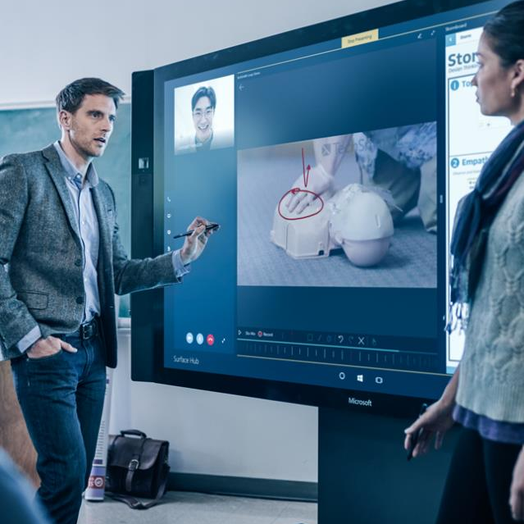
Demonstration
A Simple Runspace
Runspace VS Jobs

Slide 12

Questions?

Slide 13
Asynchronous Processing

Slide 14
Synchronous vs Asynchronous Processing
Synchronous
Executes code in order
Asynchronous
Executes code in parallel
Host is locked during execution
Host is accessible while code runs in the background
Start
Action 1
Action 2
End
Action 1
Start
<Wait>
End
Action 2

Slide 15
Asynchronous Workflow
Create
Execute
Receive output
Dispose
Load script(s)
Continue working
BeginInvoke() returns Async value
EndInvoke() requires that value to wait for and return results
Async value tracks completion with an IsComplete property
PS> $PowerShell = [PowerShell]::Create()
PS> $PowerShell.AddScript({Start-Sleep -Seconds 10;'Done'})
PS> $Async = $PowerShell.BeginInvoke()
PS> $Async.IsComplete
False
PS> $PowerShell.EndInvoke($Async)
Done
PS> $PowerShell.Dispose()

Slide 16


Thread-Safe Processing
Reading or writing to SQL
Unsafe – inside multiple runspaces
Reading files
Writing to the same file
Safe – inside multiple runspaces
Solutions
Receive all data, then create one log
Use Mutex
Separate files for each thread (not recommended)
Problem
Performing the same or conflicting action from multiple threads can cause issues
Read File 1
Start
<Wait>
Read File 1
Write File 1
Start
<Wait>
Write File 1

Slide 17
Mutexes
System-wide objects that allow for locking threads
WaitOne() will wait until mutex is available, then lock it and continue code
ReleaseMutex() will release control of the mutex to other runspaces
Coordinates actions between multiple runspaces to be thread-safe
PS> $Mutex = [System.Threading.Mutex]::new($false,"MyMutex")
PS> "Do stuff"
Do stuff
#Wait for mutex to be available, then lock it
PS> $Mutex.WaitOne()
PS> "Non-thread-safe code, like logging to a file"
Non-thread-safe code, like logging to a file
#Release for other threads
PS> $Mutex.ReleaseMutex()
PS> "Do stuff"
Do stuff

Slide 18
Demonstration
Runspace Session States

Slide 19
Questions?

Slide 20
Creating and Initializing Custom Runspaces

Slide 21
Initialization States
Initial states can be populated with variables, functions, etc.
Used to pass data to a runspace conveniently on creation
Initial states can be assigned to multiple runspaces

Slide 22
Initialization States
Determines which variables, functions, modules, and more are created
Create a default state to modify before building runspace
Create variables with: [System.Management.Automation.Runspaces.SessionStateVariableEntry]
PS> $Initialstate = [InitialSessionState]::CreateDefault()
#Data type abbreviated for readability
PS> $Var = [SessionStateVariableEntry]::New("Name","Value","Description")
PS> $Initialstate.Variables.Add($Var)
PS> $PowerShell = [PowerShell]::Create($Initialstate)
PS> $PowerShell.AddScript({$Name})
PS> $PowerShell.Invoke()
Value

Slide 23
Session State Configuration Files
Defines available variables, functions, modules, aliases, and more
Used to create InitialSessionState
Can be reused across projects when creating session states
Generated via cmdlet, but can be edited afterwards as well
PS> New-PSSessionConfigurationFile -Full –Path C:\RS.pssc
#Edit RS.pssc in a text editor
PS> $ISS = [InitialSessionState]::CreateFromSessionConfigurationFile("C:\RS.pssc")
PS> $PowerShell = [powershell]::Create($ISS)

Slide 24
PowerShell Session Configuration Sample File
@{
ScriptsToProcess = 'Get-Inputs.ps1'
PowerShellVersion = '5.1'
ModulesToImport = 'PSDiagnostics', 'Bitlocker'
AliasDefinitions = @{
'Name' = 'hlp'
'Value' = 'Get-Help' }
FunctionDefinitions = @{
'Name' = 'Get-Function'
'ScriptBlock' = {Get-Command -CommandType Function} }
VariableDefinitions = @{
'Name' = 'MyVariable'
'Value' = 'MyValue' },
@{
'Name' = 'MyVariable2'
'Value' = 'MyValue2' }
}
Load scripts on creation
Functions, aliases, and variables are represented as hash tables
Comma separation between multiple definitions

Slide 25
Demonstration
Runspace Session States

Slide 26
Questions?

Slide 27
Runspace pools

Slide 28

Runspace Pools
Reusable threads
BeginInvoke() is used to queue PowerShell instances
Picks up the next instance from the queue when there is an open thread
Improves performance
Simplifies max thread management
Session state can be set for entire pool
Queued work (PowerShell Instances)
Runspace Pool
Thread 1
Thread 2
Thread 3
Thread 4

Slide 29
Runspace Pool Workflow
Create a RunspacePool
Open RunspacePool
Create a list to track PowerShell Instances
Create PowerShell Instance(s)
Assign instance(s) to the RunspacePool
Store instance(s) in the list
Call BeginInvoke() and track token
Receive data with EndInvoke()
Dispose of PowerShell Instance(s)
Dispose of RunspacePool
Notes:
Remember that this does not make the code easier, the workflow still contains all the creation and disposing of the runspaces

Slide 30
RunspacePool Example
$RunspacePool = [runspacefactory]::CreateRunspacePool(1,5)
$RunspacePool.Open()
[System.Collections.ArrayList]$RunspaceList = @()
Foreach($Instance in 1..10) {
$PowerShell = [powershell]::Create()
$PowerShell.RunspacePool = $RunspacePool
[void]$PowerShell.AddScript({
param ($InstanceNumber)
$timeToSleep = get-random -Minimum 10 -Maximum 60
Start-Sleep -Seconds $timeToSleep
"Runspace $InstanceNumber took $timeToSleep seconds!"
})
[void]$PowerShell.AddParameter("InstanceNumber",$Instance)
$RunspaceList.Add([pscustomobject]@{
InstanceNumber = $Instance
PowerShell = $PowerShell
AsyncResult = $PowerShell.BeginInvoke()
})
}

Slide 31
RunspacePool Example - Fetching Results
Foreach($Instance in $RunspaceList)
{
$Instance.PowerShell.Endinvoke($Instance.AsyncResult)
$Instance.PowerShell.Dispose()
}
$RunspacePool.dispose()
Runspace 1 took 39 seconds!
Runspace 2 took 39 seconds!
Runspace 3 took 33 seconds!
Runspace 4 took 37 seconds!
Runspace 5 took 37 seconds!
Runspace 6 took 34 seconds!
Runspace 7 took 16 seconds!
Runspace 8 took 34 seconds!
Runspace 9 took 50 seconds!
Runspace 10 took 36 seconds!

Slide 32
Demonstration
Runspace Pools

Slide 33
Questions?

Slide 34
Debugging Runspaces

Slide 35


Debugging a Runspace
Can attach to runspace and use command line debugger
Debug-Runspace starts debug session with runspace via object or name
Get-Runspace to list runspaces within the current PowerShell hosts
Debugging runspaces in a different host gets complicated
Notes:
Reference: https://docs.microsoft.com/en-us/powershell/module/microsoft.powershell.utility/debug-runspace?view=powershell-6

Slide 36
Debugging example
PS> $PowerShell = [powershell]::Create()
PS> $PowerShell.AddScript({
do{
$Count = 1 + $Count
Start-Sleep 5
}while($true)
})
PS> $async = $PowerShell.BeginInvoke()
PS> Debug-Runspace -Runspace $PowerShell.Runspace
Debugging Runspace: Runspace2
Stopped at: Start-Sleep 5
[DBG]: [Process:34644]: [Runspace2]: PS C:\Users\Power>> L
1:
2: do{
3: $Count = 1 + $Count
4:* Start-Sleep 5
5: }while($true)
Command Line Debugging

Slide 37
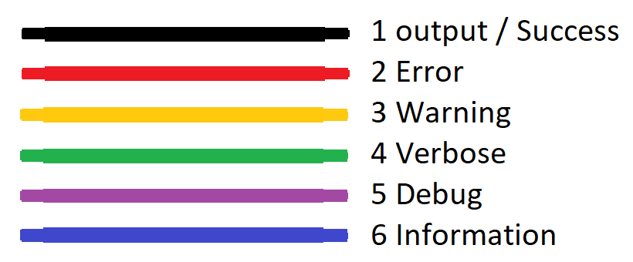
Debugging Tips
All streams viewable from property
Test all code before adding to runspaces
Modules exist to simplify this process
PS> $PowerShell = [PowerShell]::Create()
PS> $PowerShell.AddScript({1/0})
PS> $PowerShell.Invoke()
PS> $PowerShell.Streams
Error : {Attempted to divide by zero.}
Progress : {}
Verbose : {}
Debug : {}
Warning : {}
Information : {}

Slide 38
Multithreading on PowerShell 7
Built-in threading via ForEach-Object -Parallel
ThreadJob Module
Allows jobs to use threads instead of separate processes via Start-ThreadJob
Uses regular job cmdlets (wait, receive, stop)
Session customization is limited
$StartTime = get-date
1..10 | ForEach-Object -Parallel {
"Output: $_"
Start-Sleep 1
}
((get-date) - $StartTime).Seconds
PS> $TJ = Start-ThreadJob -ScriptBlock {
Start-sleep 10
"End"
}
PS> Write-Host "Do Stuff"
Do Stuff
PS> Wait-Job $TJ | out-null
PS> Receive-Job $TJ
End
Output: 1
Output: 2
Output: 3
Output: 4
Output: 5
Output: 6
Output: 7
Output: 8
Output: 9
Output: 10
2

Slide 39
Demonstration
Runspace Debugging

Slide 40
Questions?

Slide 41

Runspaces
60 minutes

